Slide 1
Who’s Egg is it, anyway?
Choose the egg that belongs to the chicken pictured

Slide 2
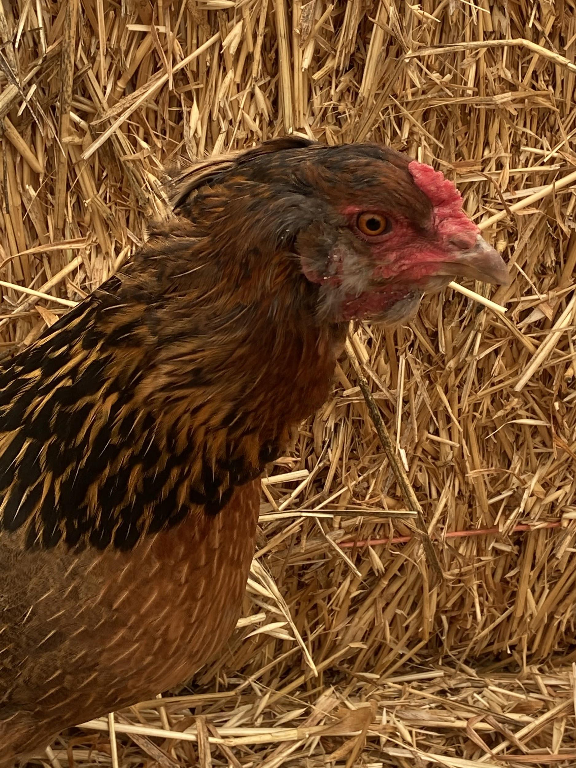
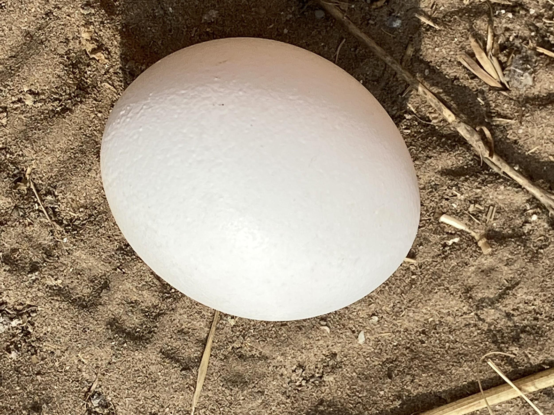
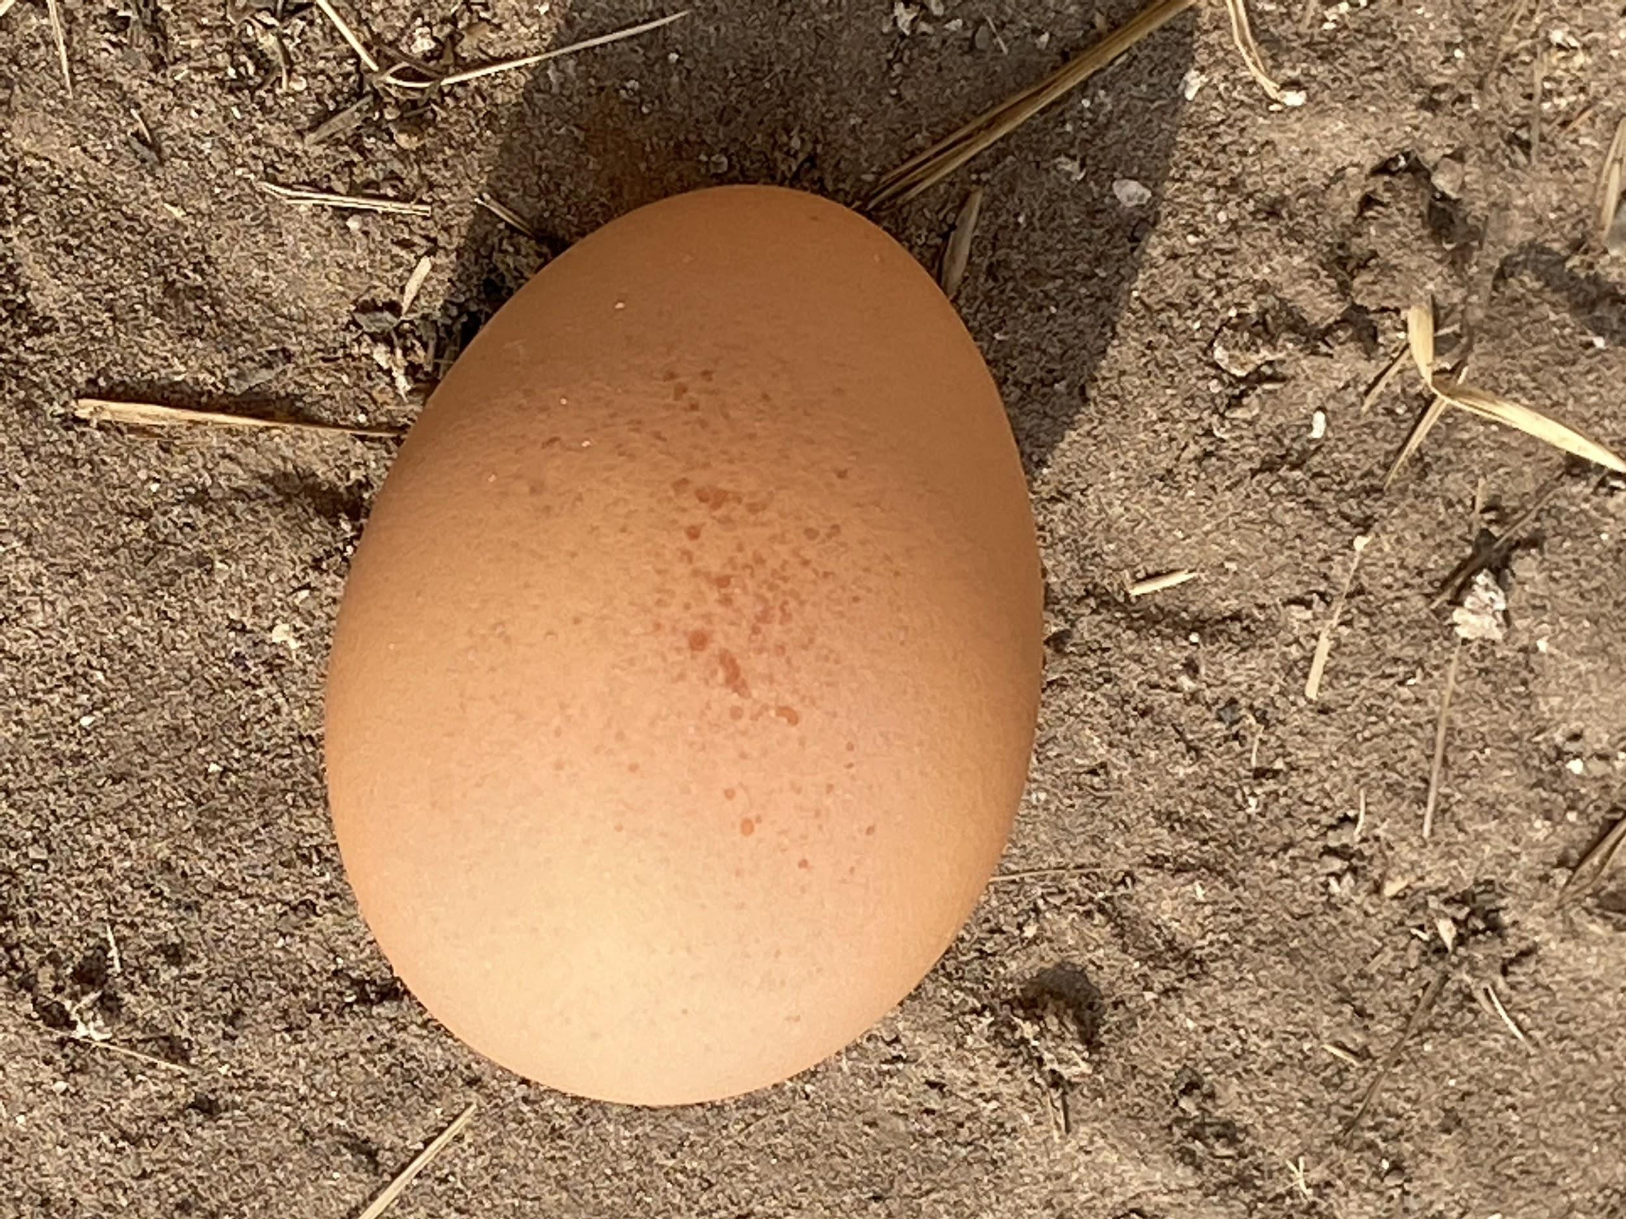
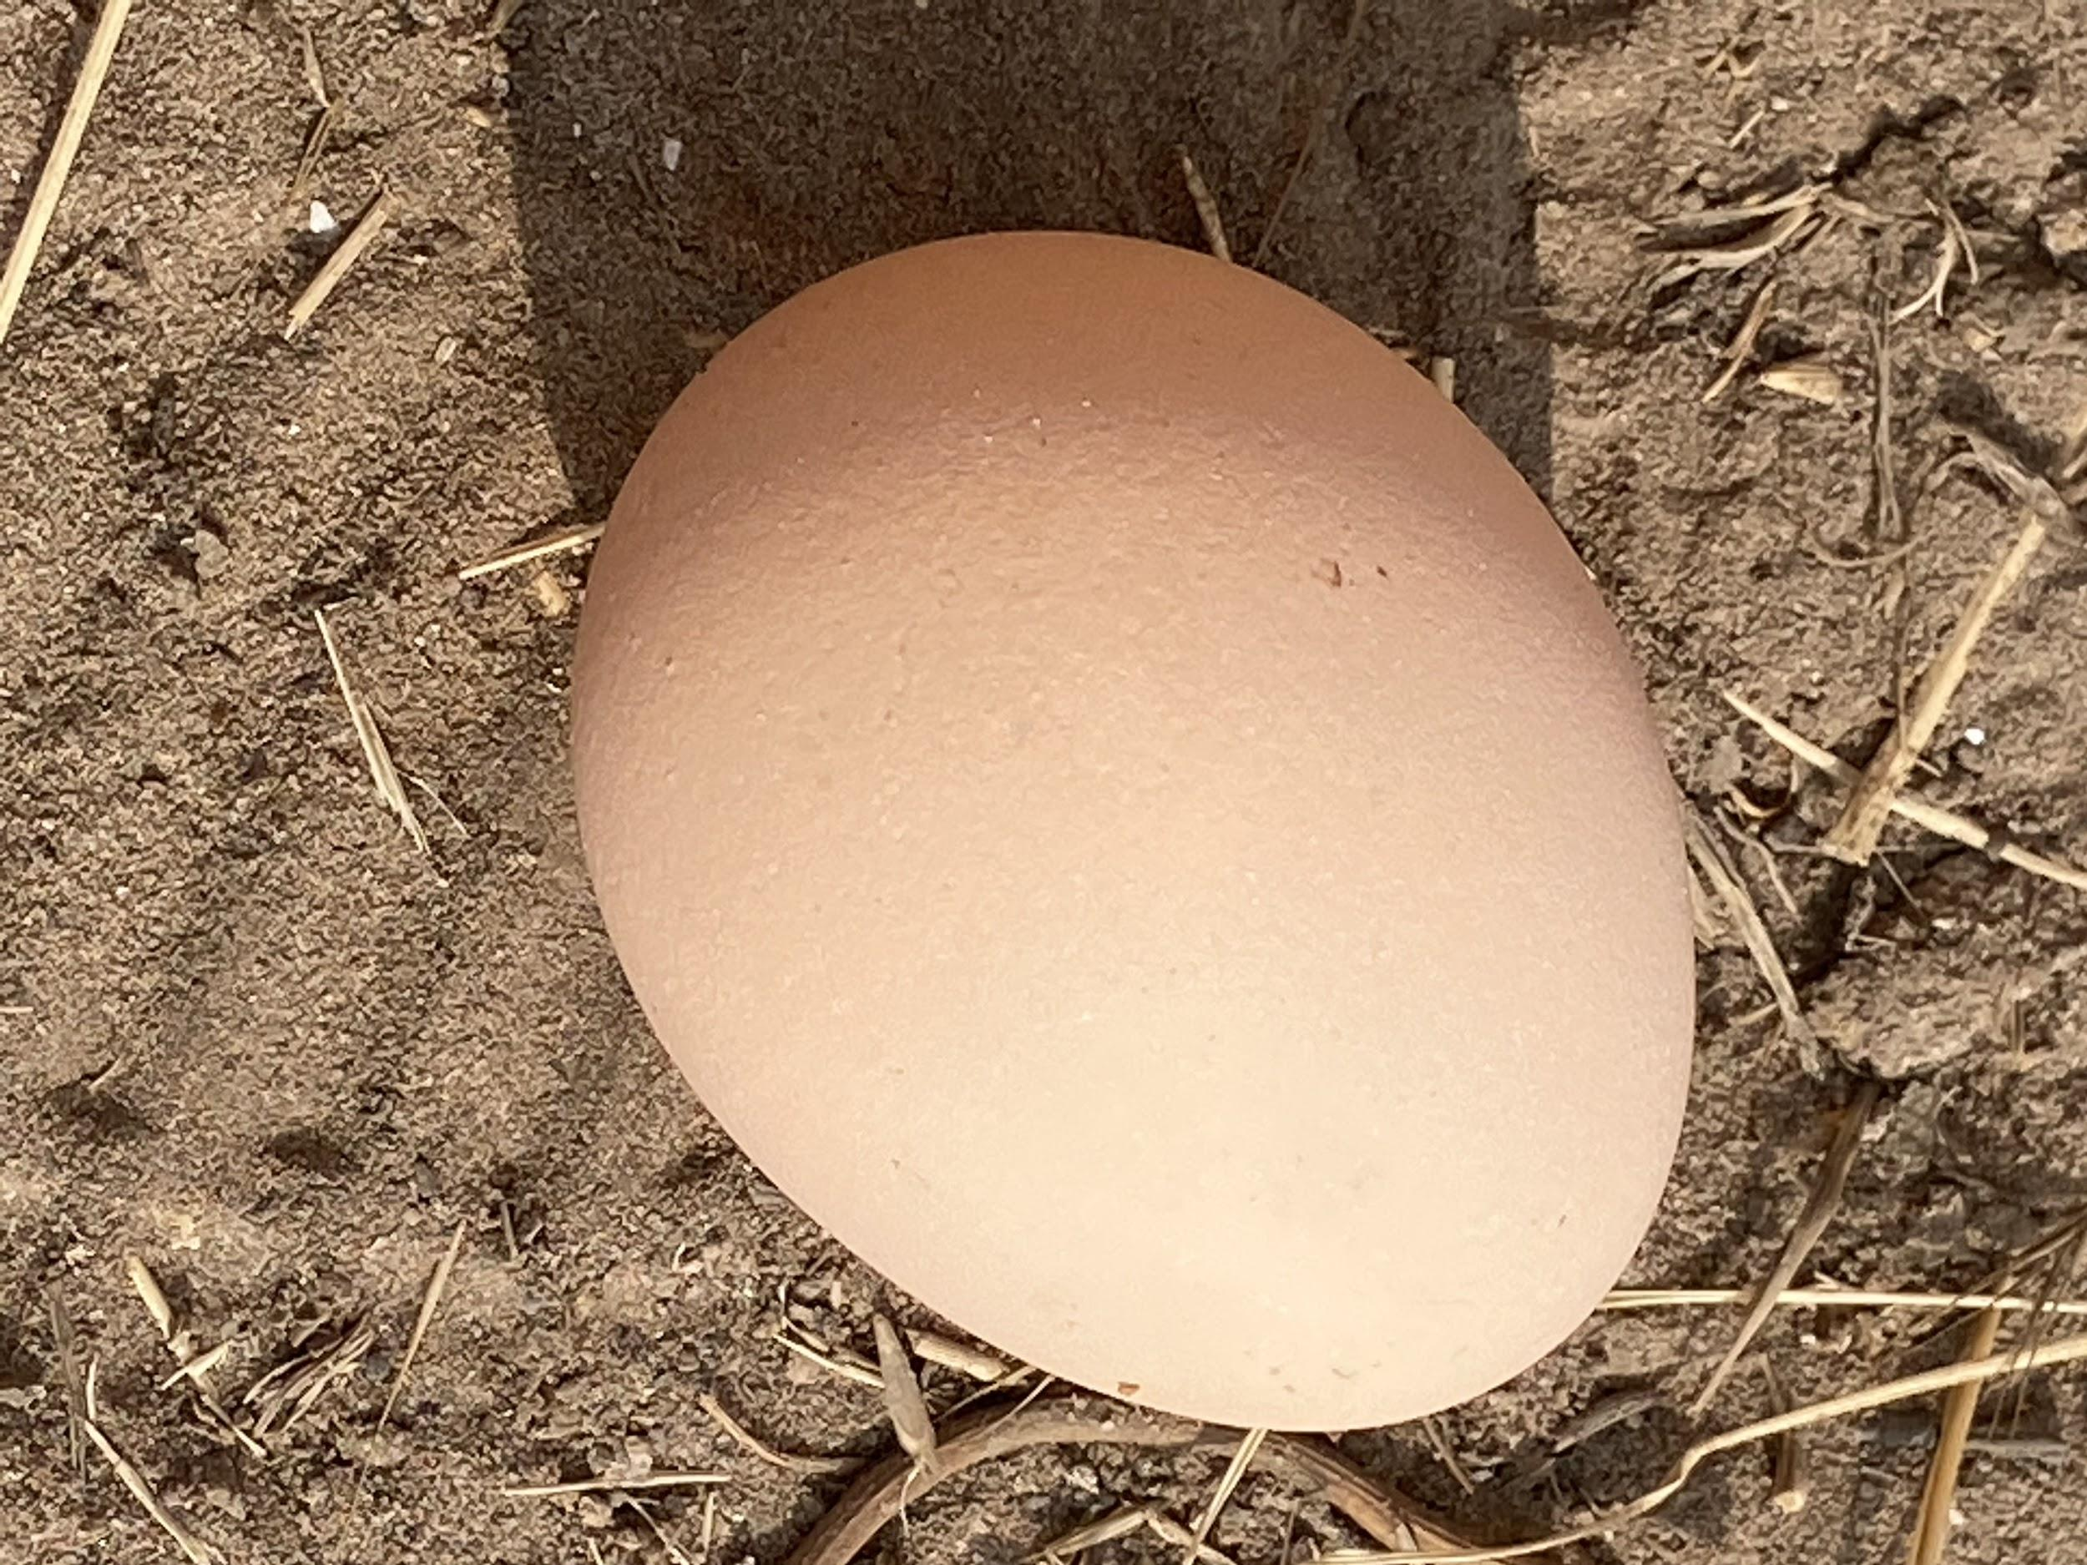
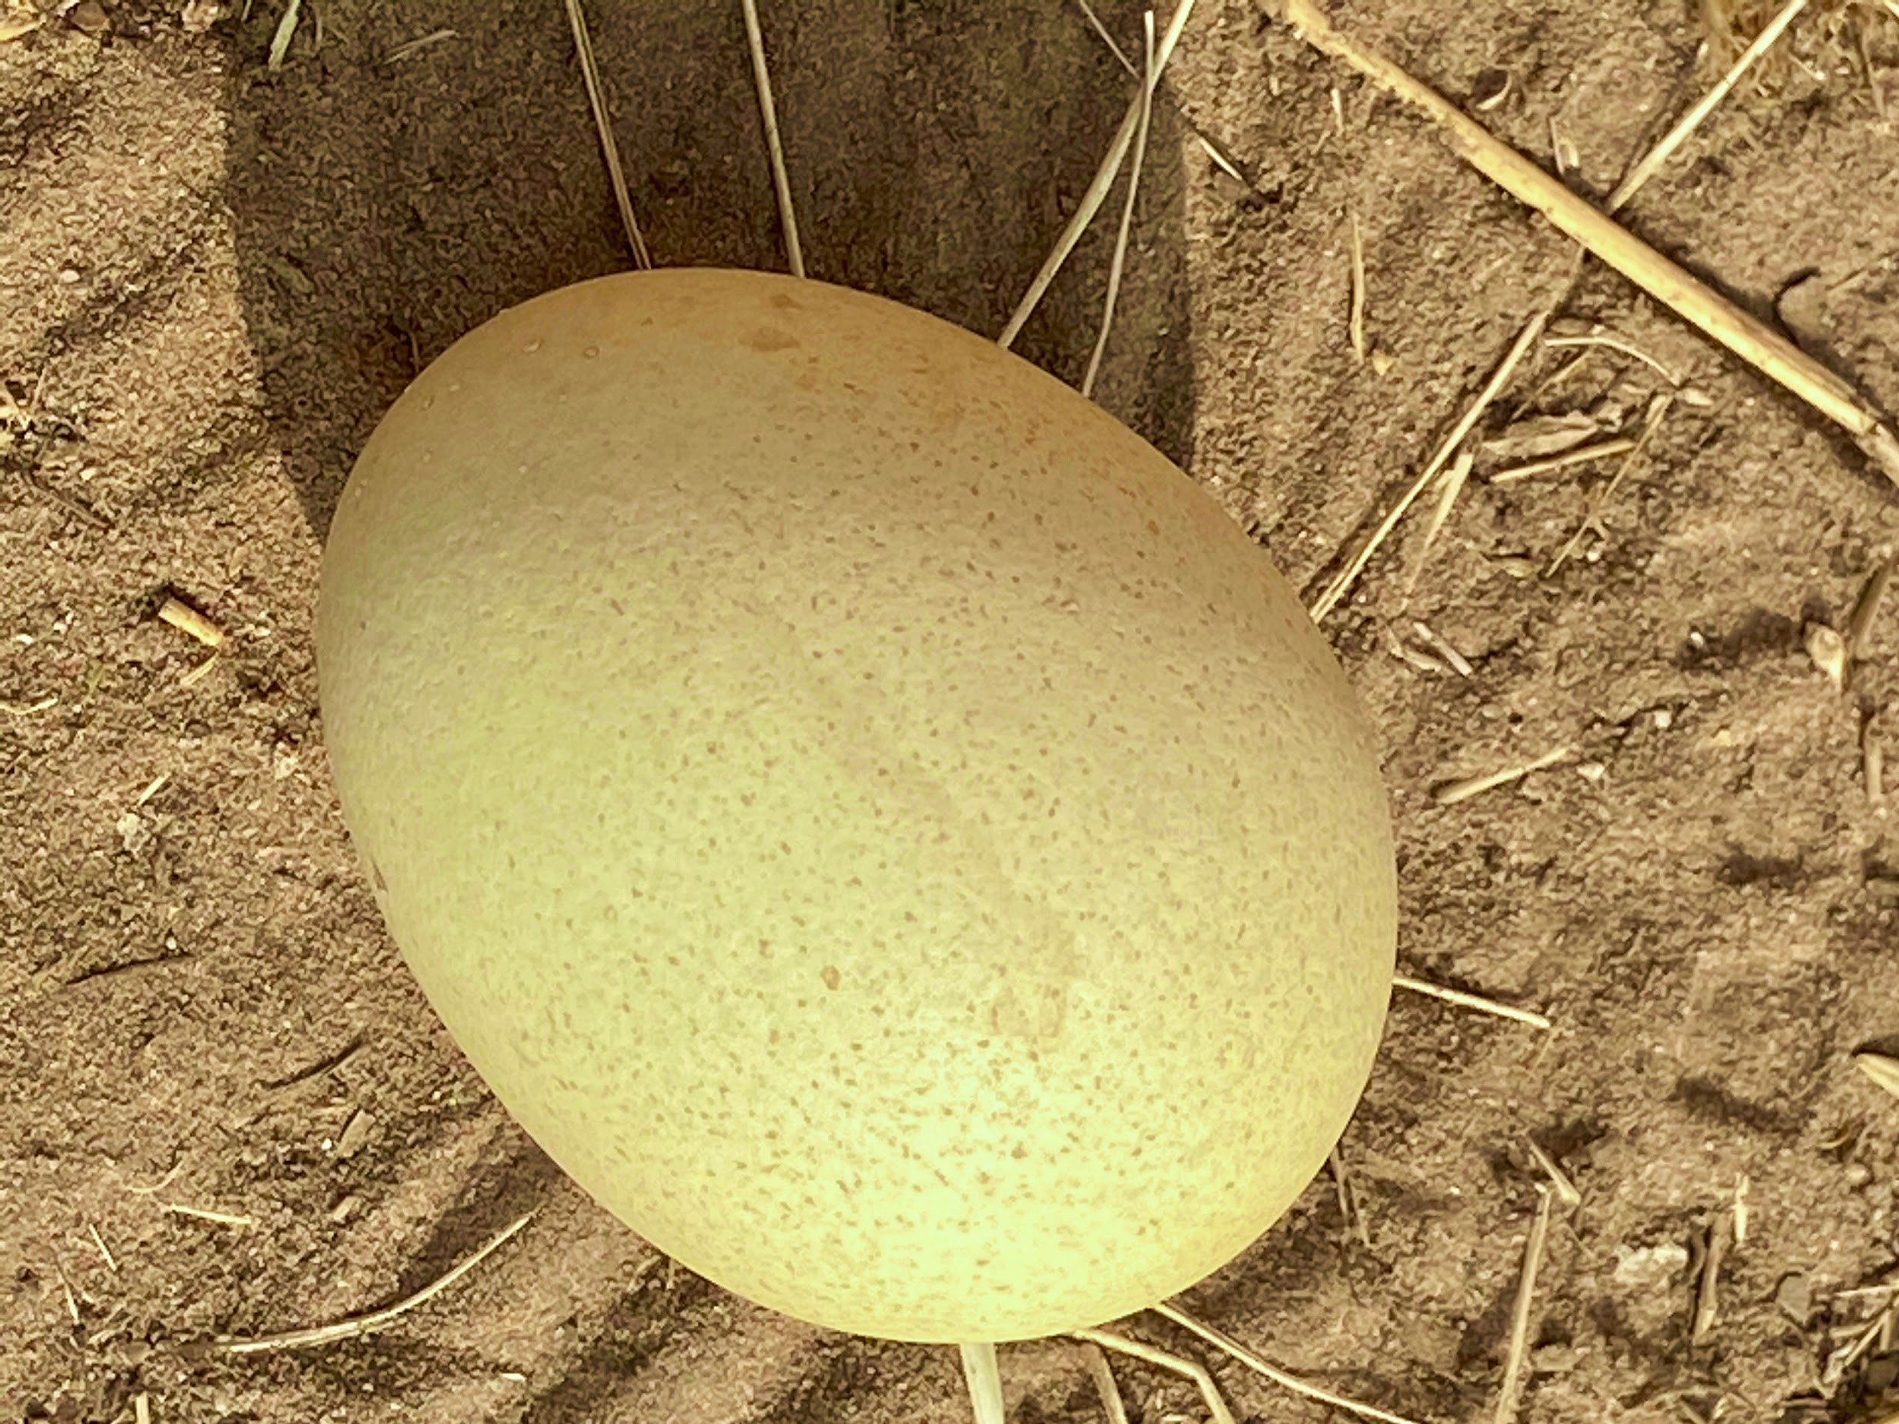
A
B
C
D

Slide 3
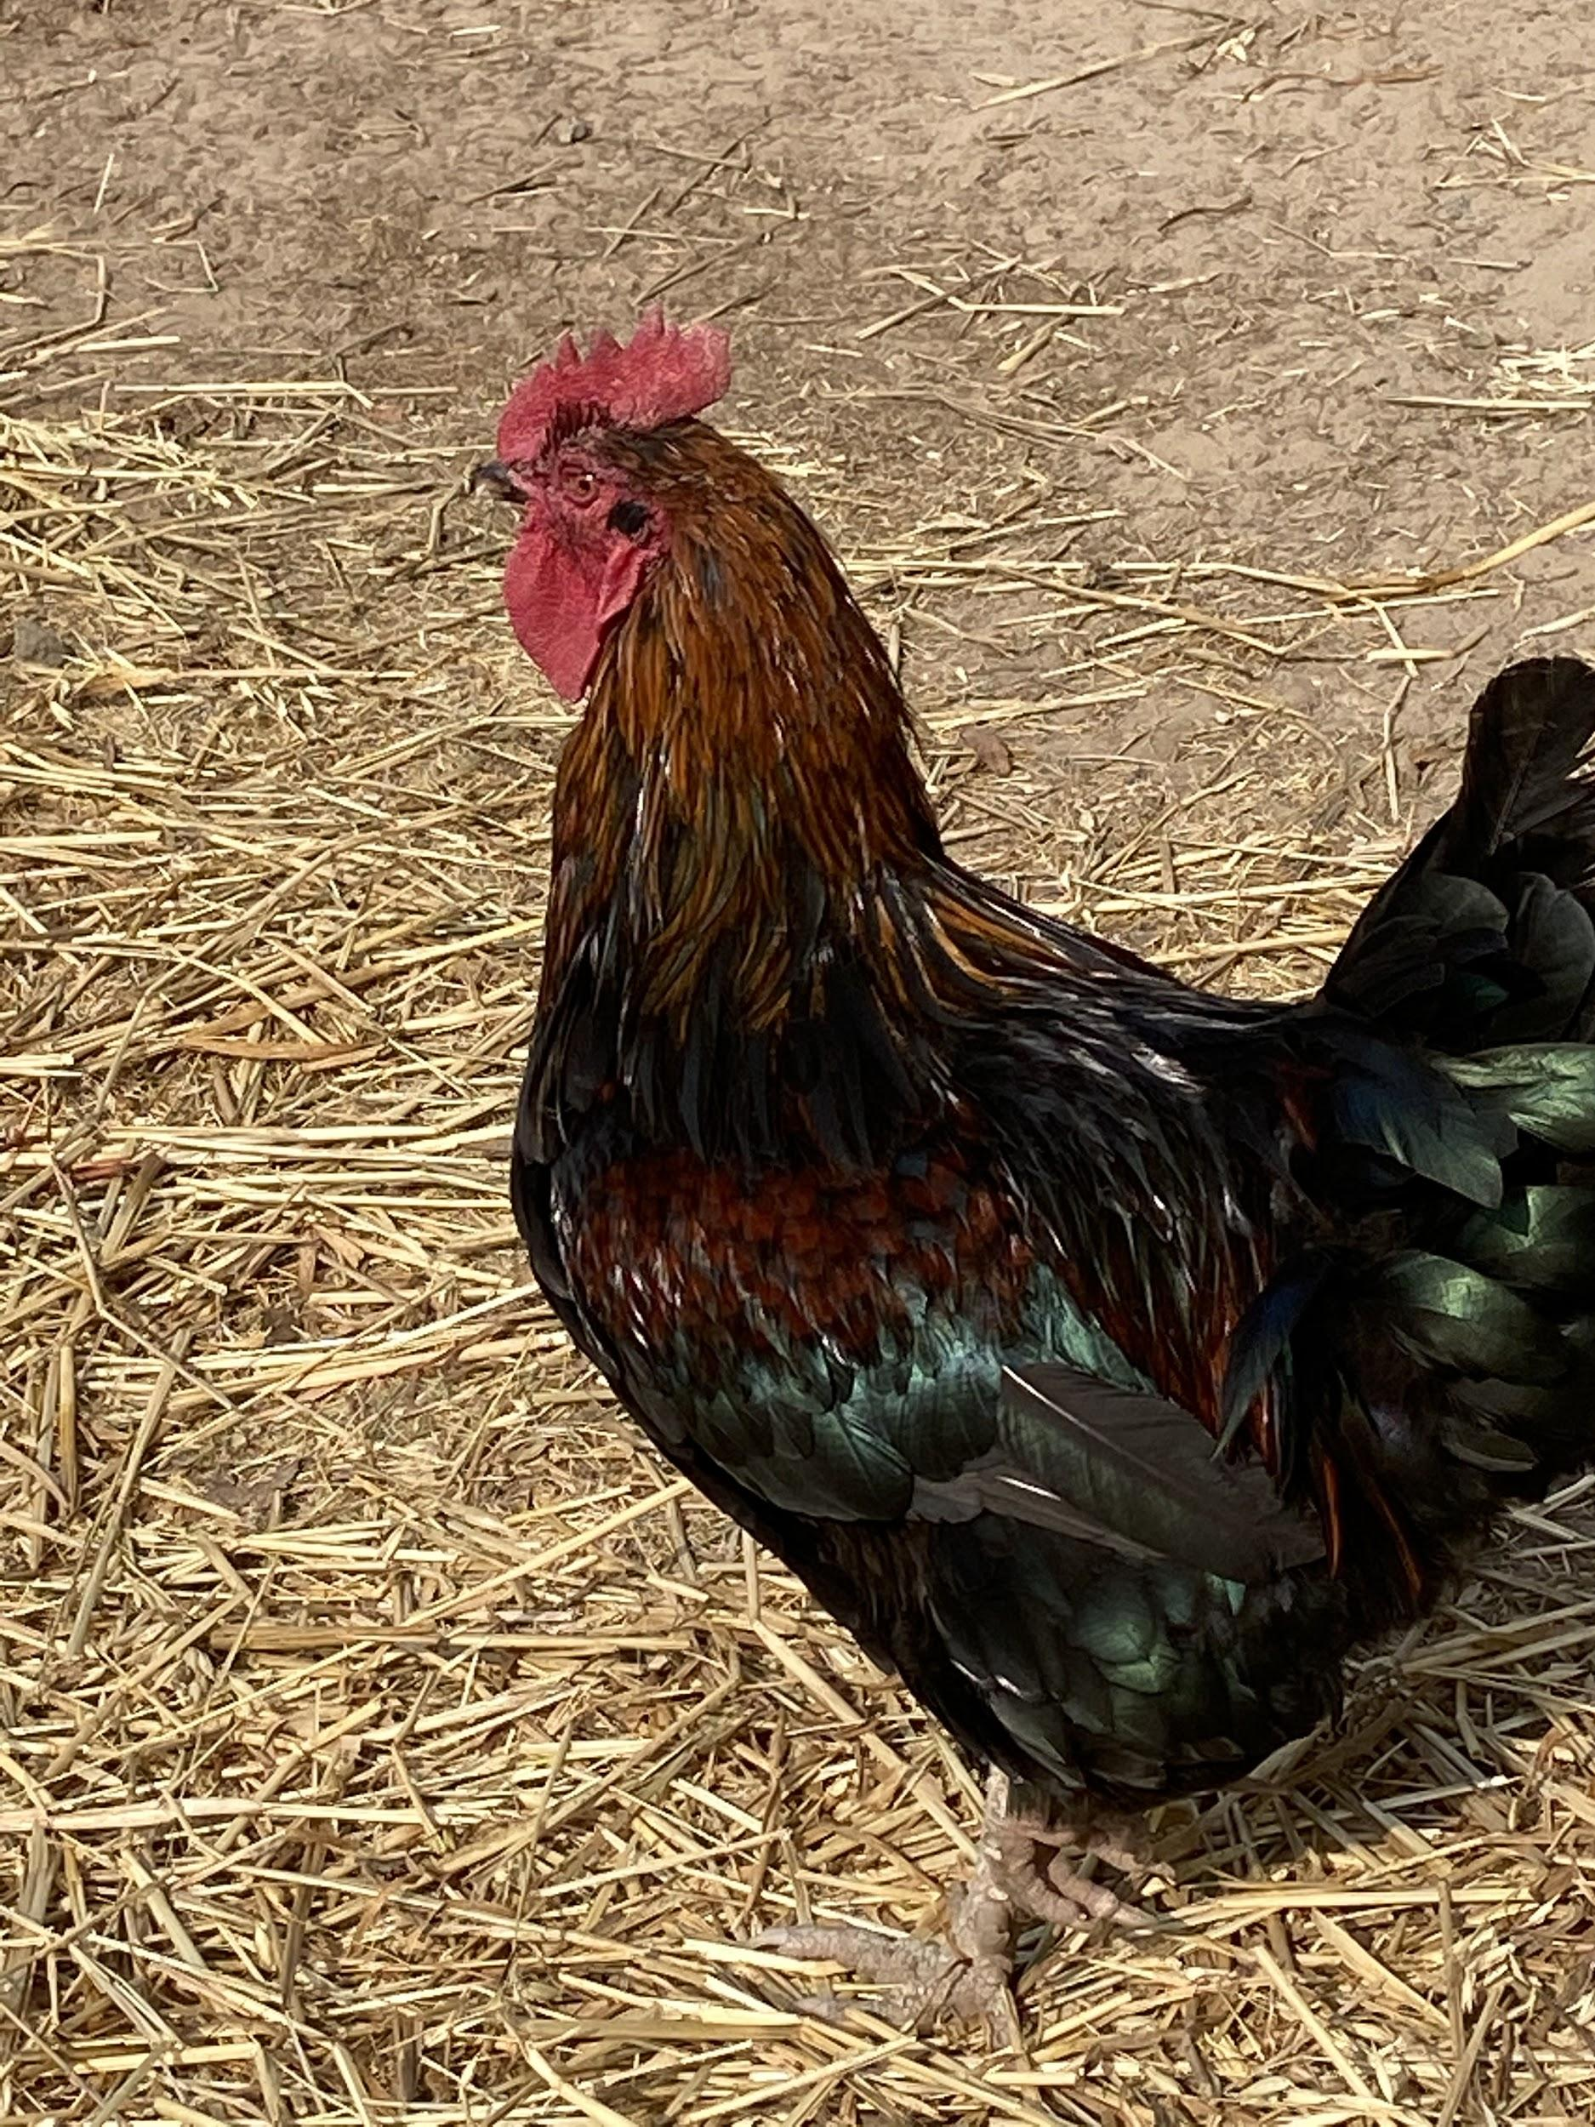
A
B
C
D

Slide 4
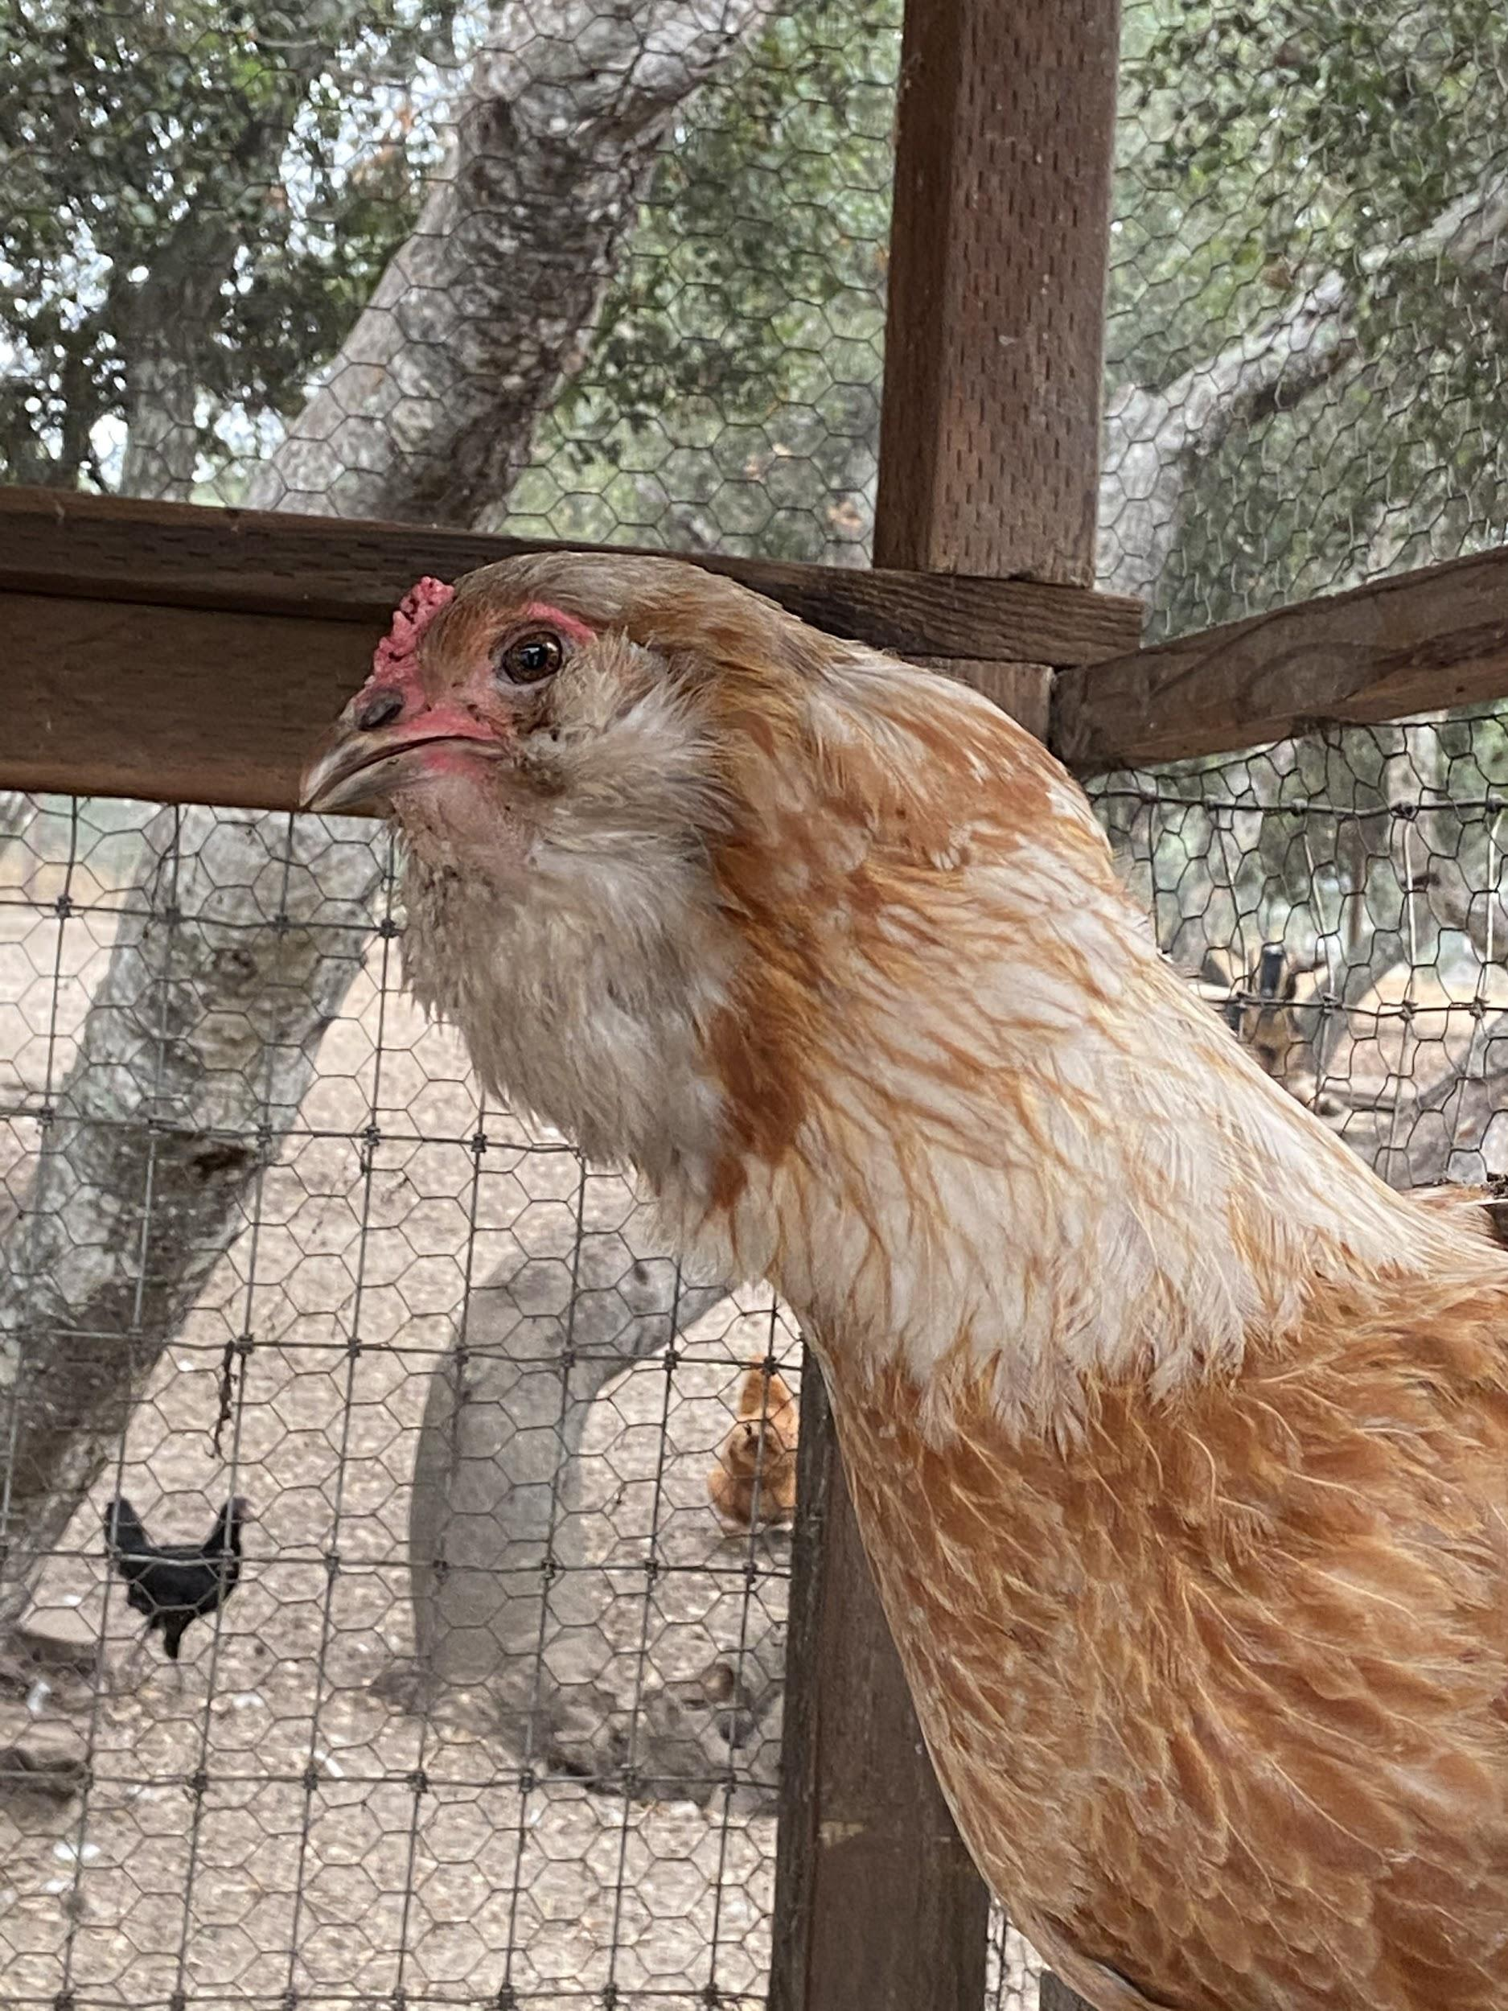
A
B
C
D

Slide 5
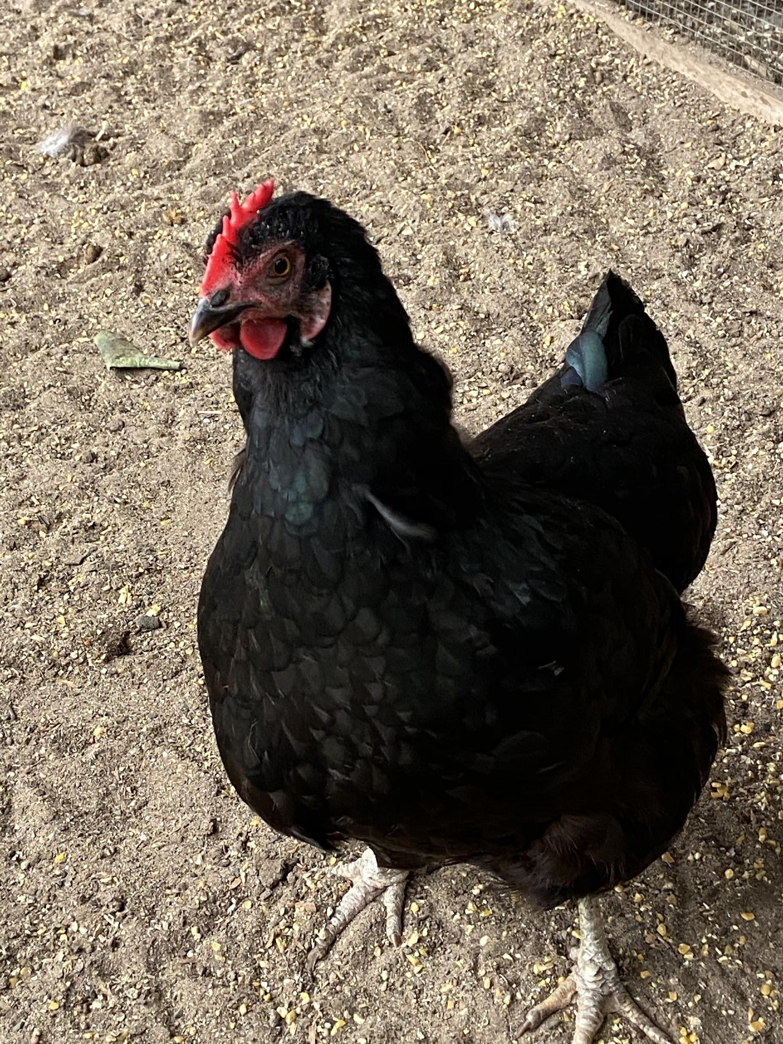
A
B
C
D

Slide 6
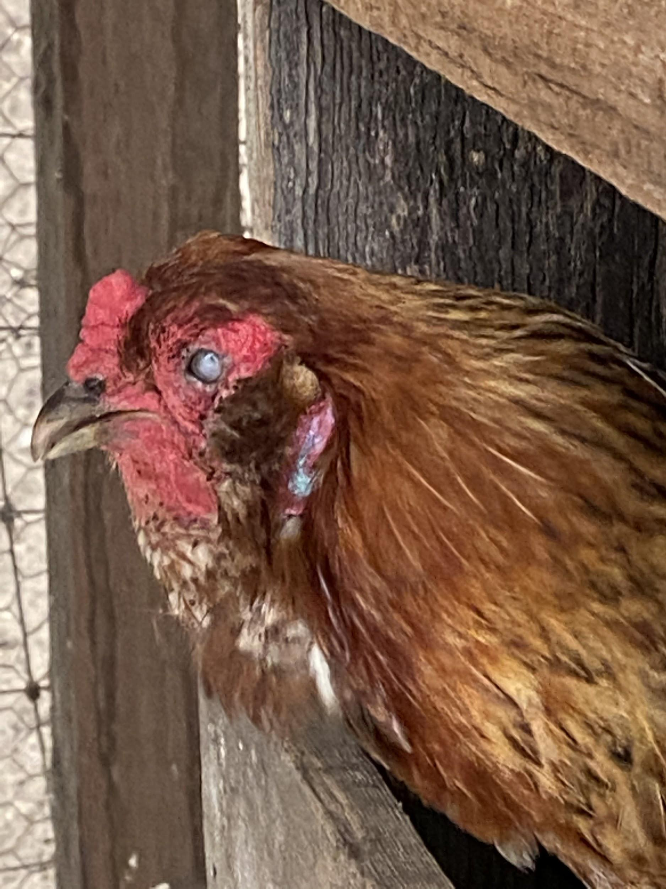
A
B
C
D

Slide 7
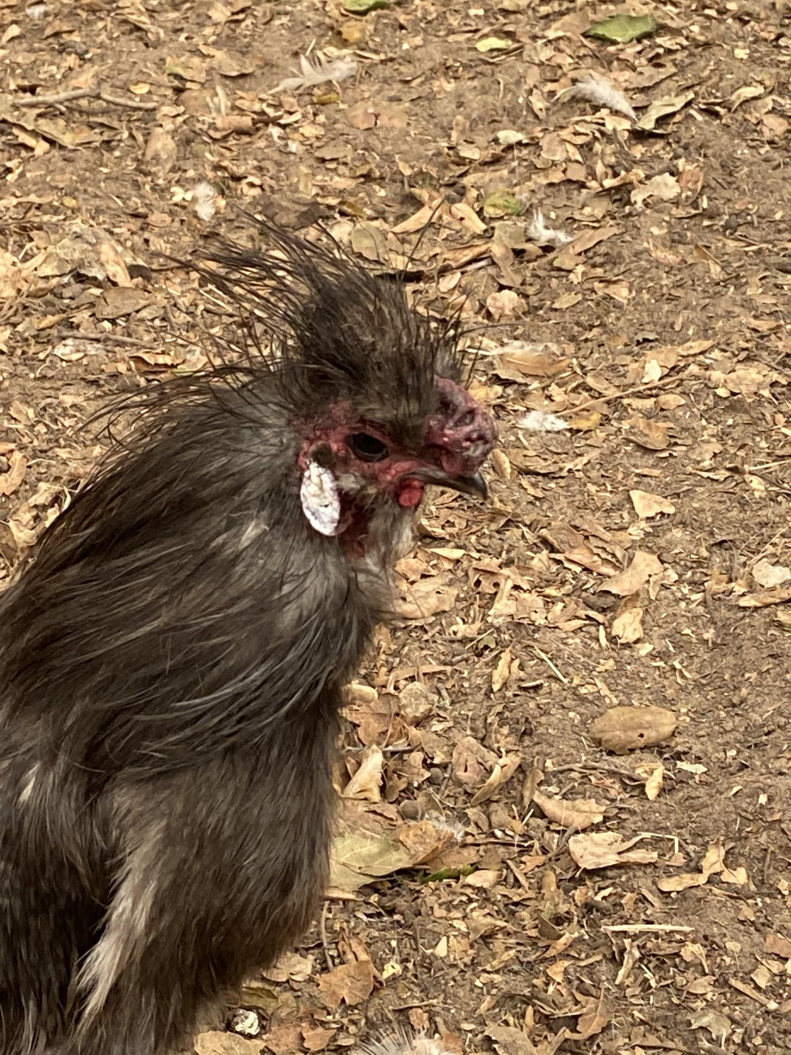
A
B
C
D

Slide 8
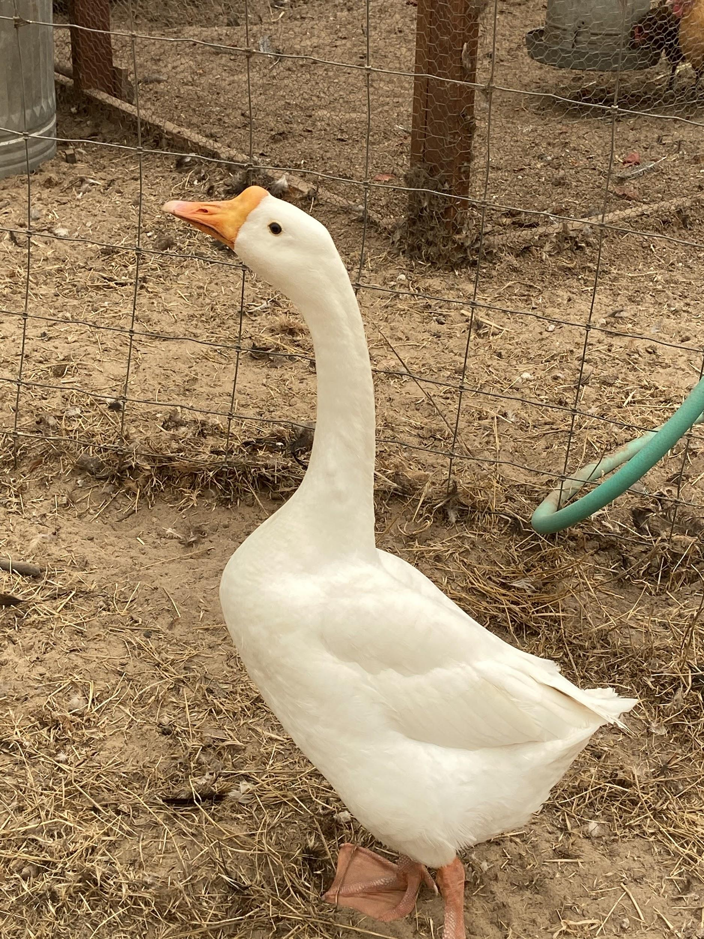
A
B
C
D

Slide 9
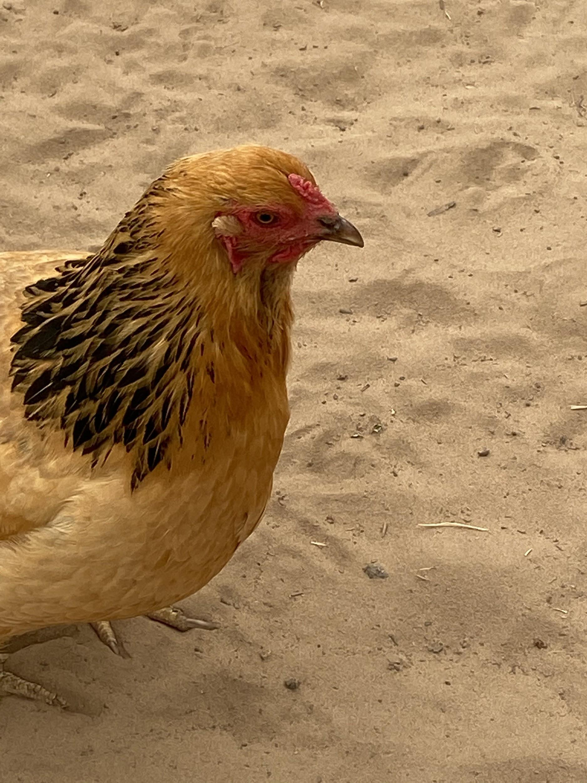
A
B
C
D

Slide 10
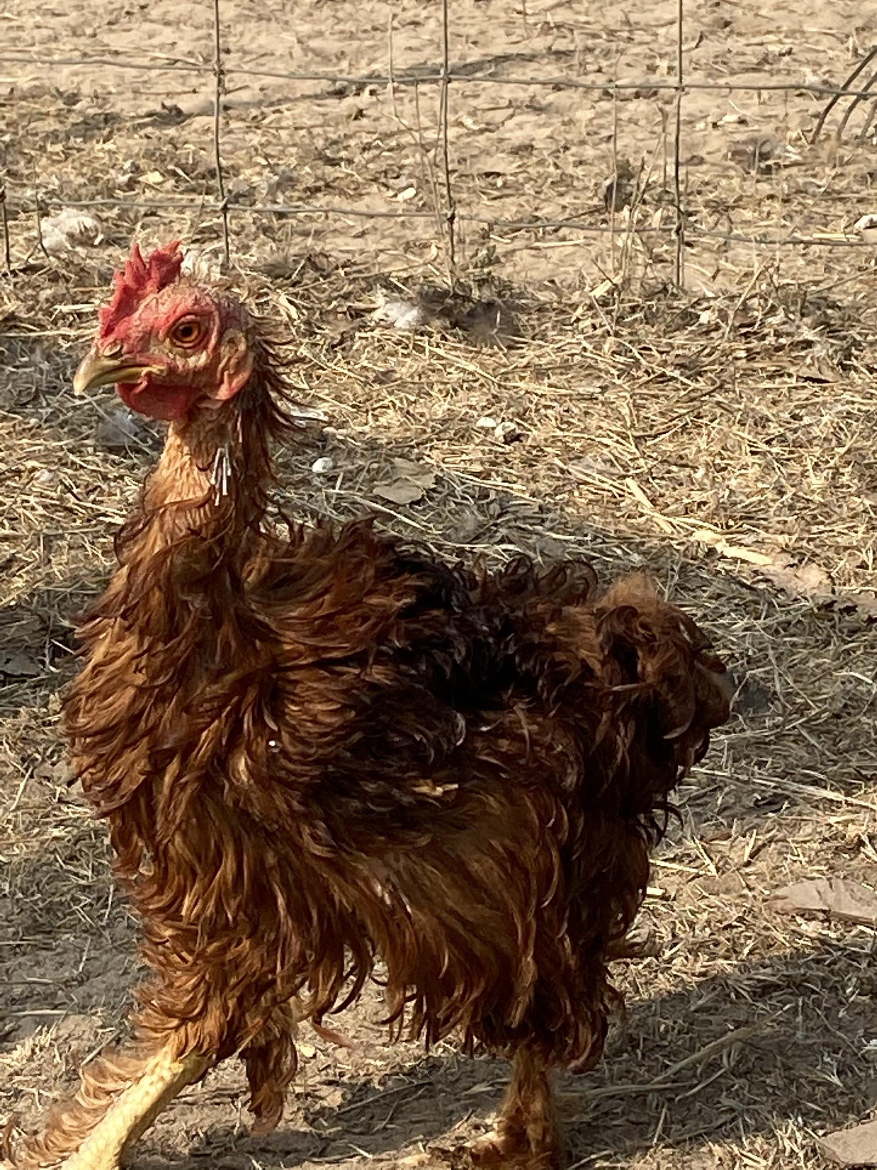
A
B
C
D

Slide 11
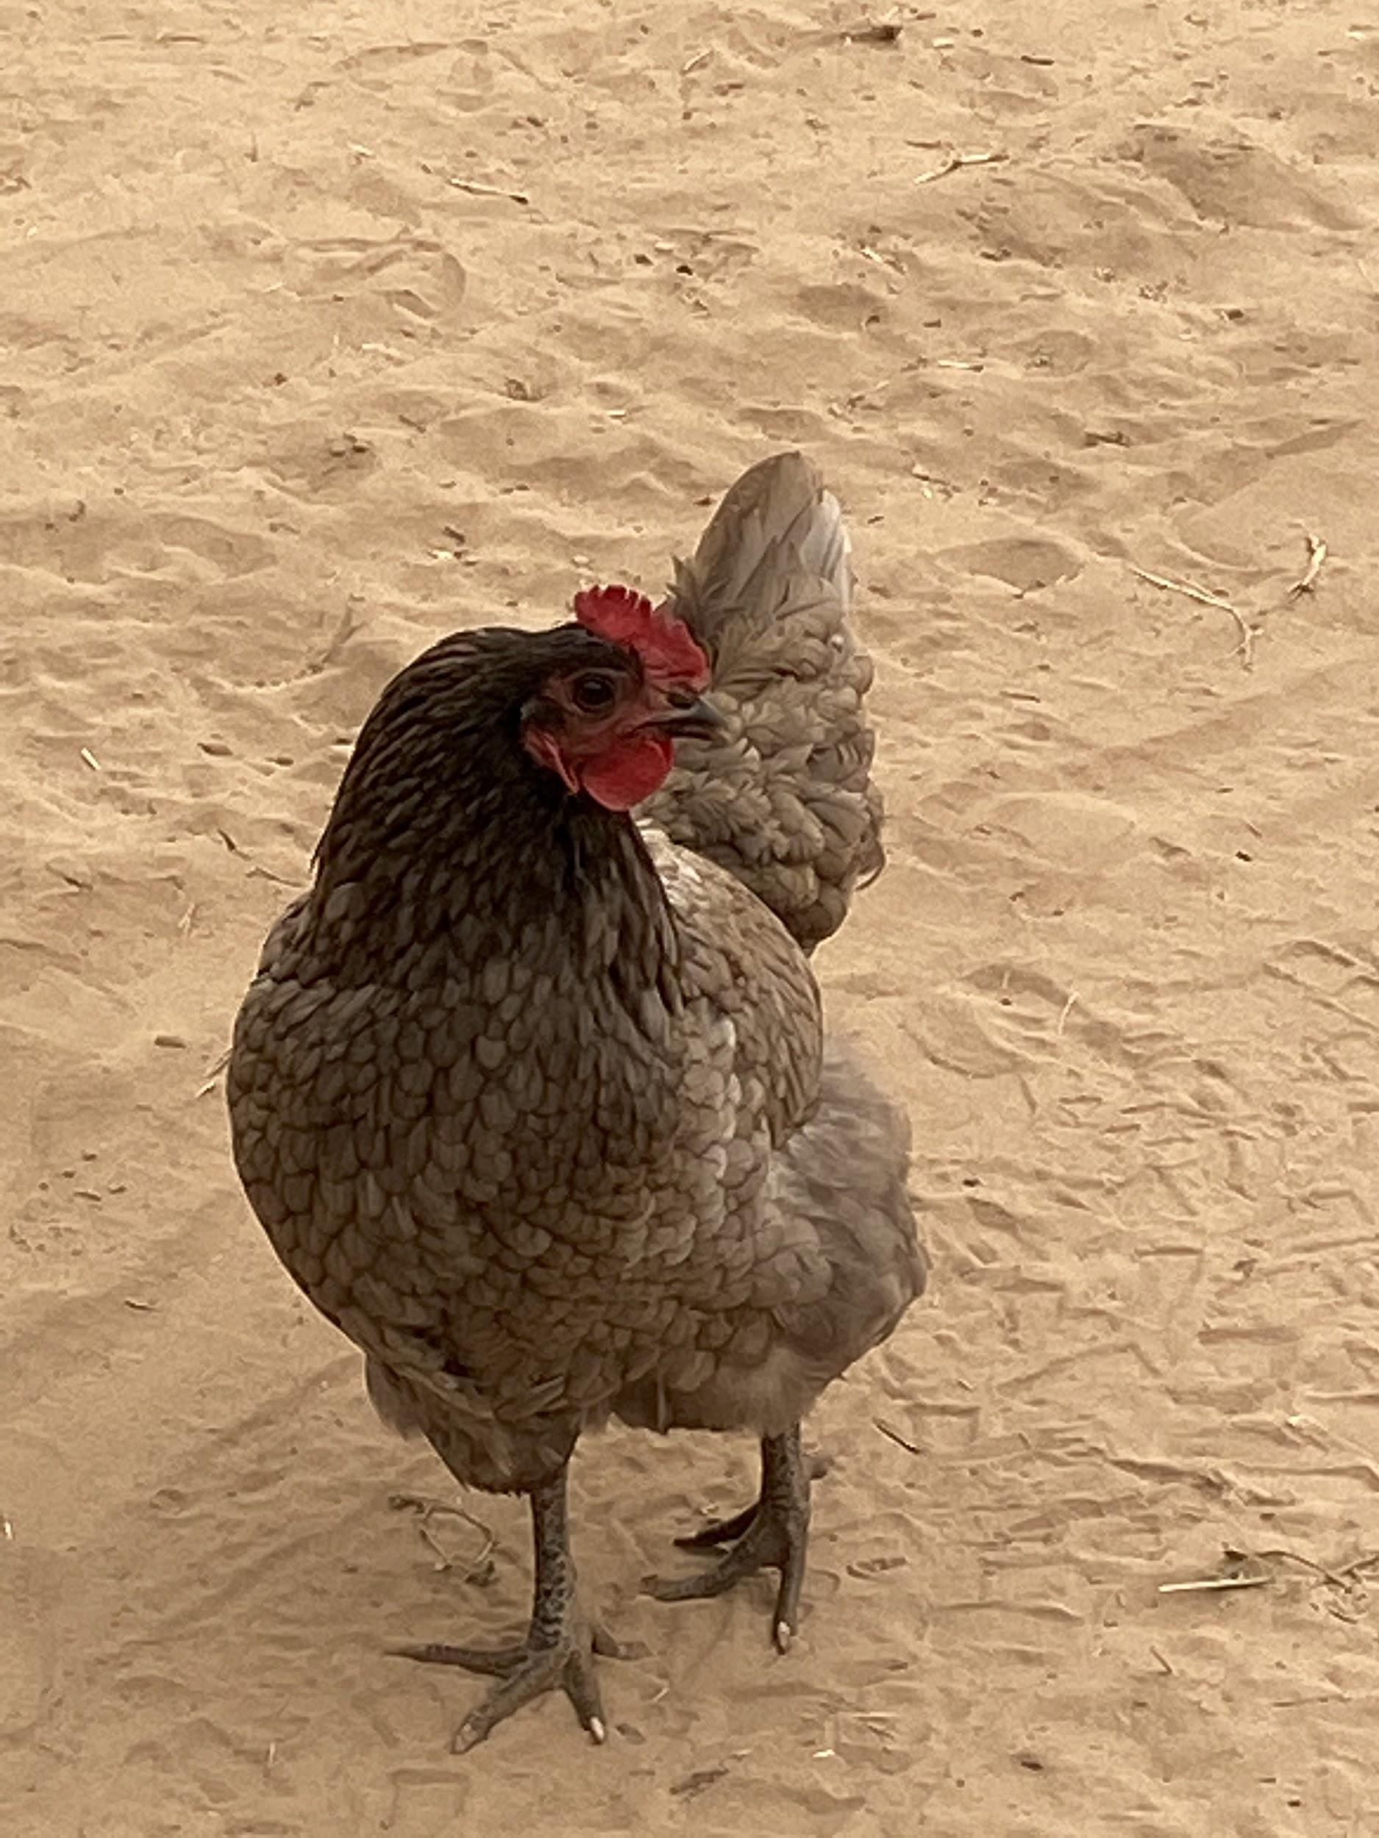
A
B
C
D

Slide 12
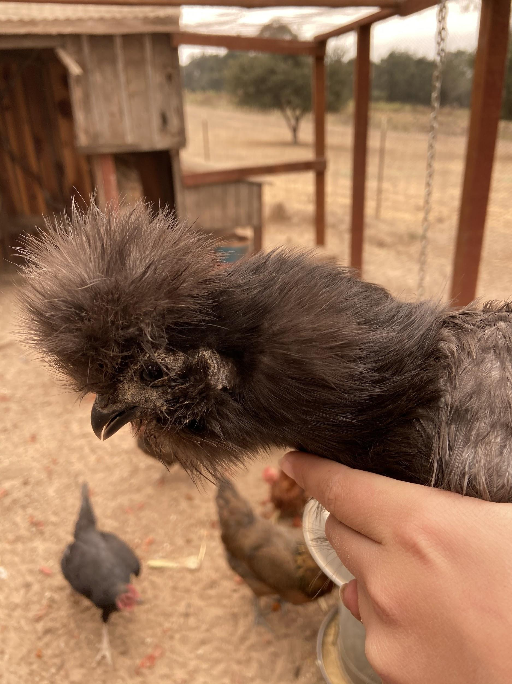
A
B
C
D

Slide 13
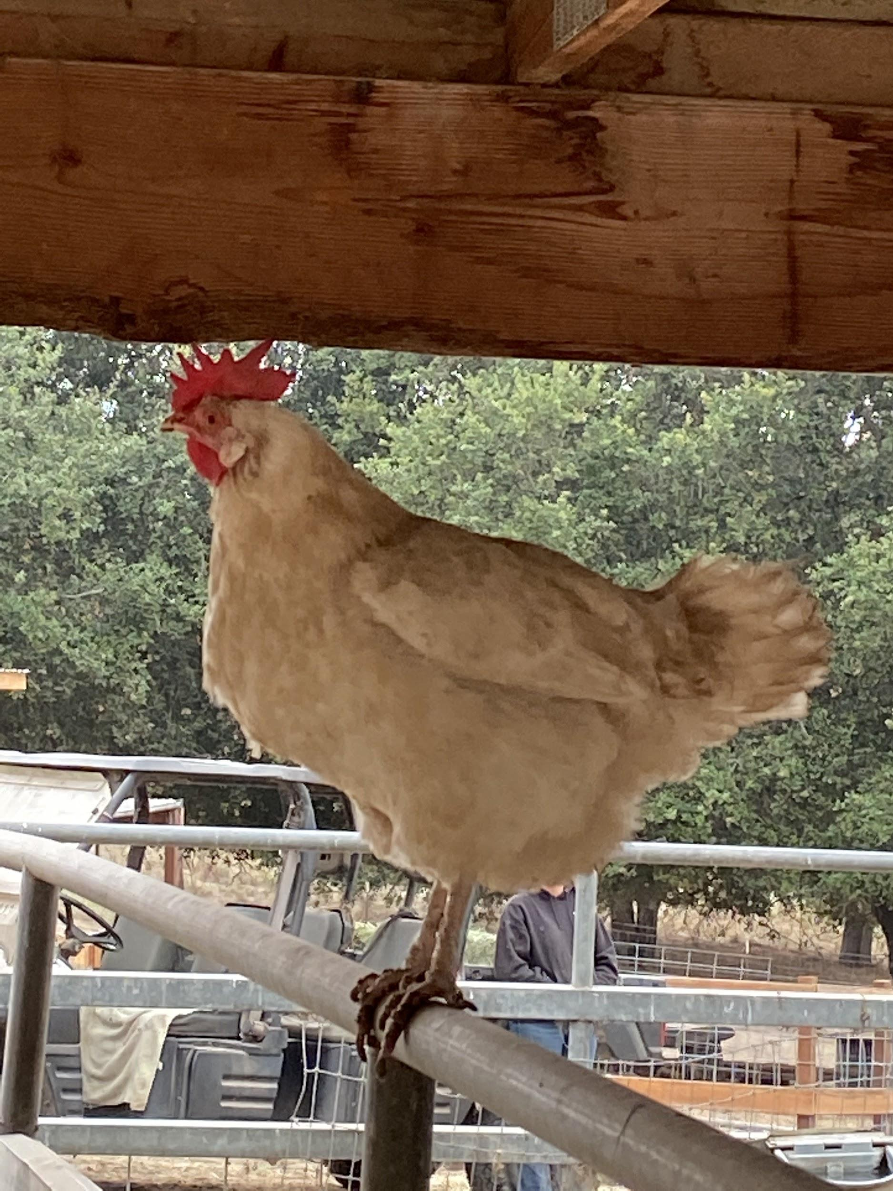
A
B
C
D

Slide 14
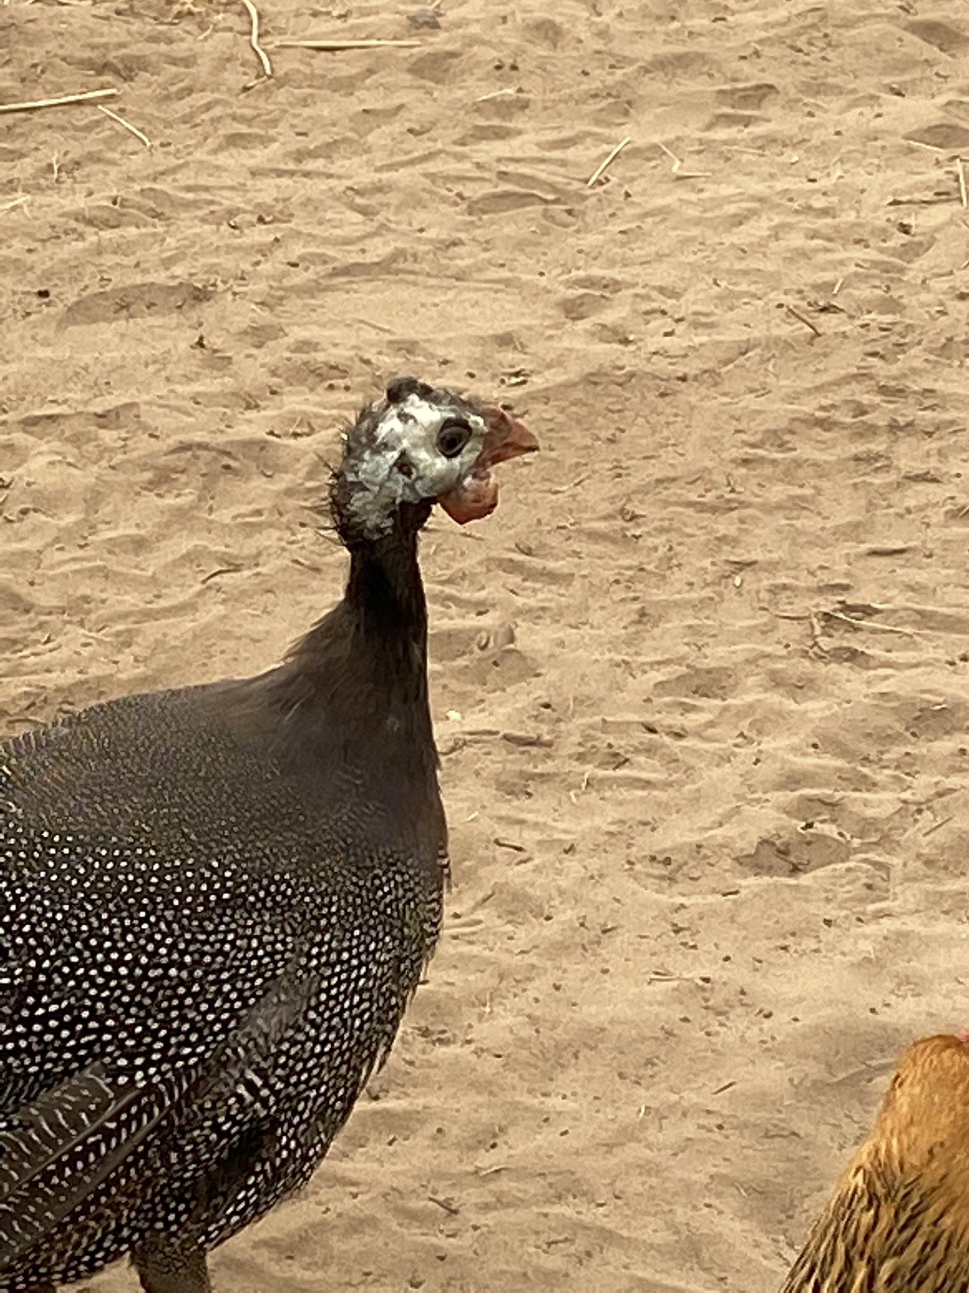
A
B
C
D

Slide 15
Answer Key:
1: B - Brown, but this breed (easter egger) can also lay blue and green. | 8: C - brown
2: Trick question, this is a Rooster | 9: Trick Question - This is Frizzle rooster with a double frizzle gene - makes him have a naked neck.
3: D - green | 10: C - Brown
4: B - dark brown | 11: C - light brown, almost white
5: D - green | 12: A - White, Leghorn Hen - Traditional egg layer.
6: Trick - Silkie Rooster! | 13: Guinea fowl - too young to lay eggs yet!
7: Trick question, geese don’t have fleshy earlobes, but she will lay white eggs.

